Slide 1


Interpretation and use of patient-reported outcome measures through a philosophical lens
BC Cancer Patient Centred Measurement
July 4th, 2019
Jae Yung Kwon, RN, PhD (c)
Registered Nurse & PhD Candidate, School of Nursing, UBC (sub-specialization in Measurement, Evaluation and Research Methodology, Faculty of Education, UBC)

Slide 2
Outline
Background
Three tenets
Contextual elements
Dialectical interaction
Openness and reflexivity
Considerations
Practical implications
Patient-reported outcome measures (PROMs)
Problem statement
Hermeneutics
Key guiding questions
Consequences of asking these questions

Slide 3
Acknowledgements
Dr. Richard Sawatzky (co-supervisor), Professor of Nursing, Trinity Western
Dr. Sally Thorne, Professor of Nursing, UBC
Related reference: Kwon, Jae Yung, Sally Thorne, and Richard Sawatzky
(2019) Interpretation and Use of Patient-Reported Outcome Measures through a Philosophical Lens. Quality of Life Research: An International Journal of Quality of Life Aspects of Treatment, Care and Rehabilitation 28(3): 629–636.

Slide 4
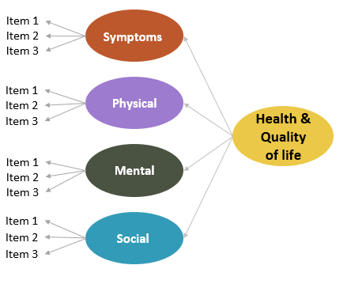
Patient-reported Outcome Measures (PROMs)
Multi-item scales administered to patients to assess their perspectives of their health & quality of life.
Assess the impact of disease and treatment from a patient’s point of view, including their symptoms and physical, mental and social health status (Deshpande et al., 2011).

Slide 5
Problem statement
Use of PROMs is complicated by tensions that may arise to achieve different healthcare goals and competing priorities:
Individual patient level
Enhance communication between patients and clinicians
Improve detection of patient problems
Inform patient-centred decision-making
Aggregate level (e.g., group practices, hospitals, and organizations)
Quality improvement, accreditation & comparison of healthcare organizations

Slide 6
Hermeneutics
Hermeneutics can be used to examine how different users (e.g., patients, clinicians, administrators, and policy-makers) interpret and use PROMs and the broader context.
both a philosophy and methodology concerned with the nature of interpretation (Gadamer, 1998).
emphasizes the dialectical processes that occur during the interpretation of PROMs, in which underlying assumptions are identified and examined
Notes:
Hermeneutics focuses on how we looking and interpreting the world that we are living in.

Slide 7
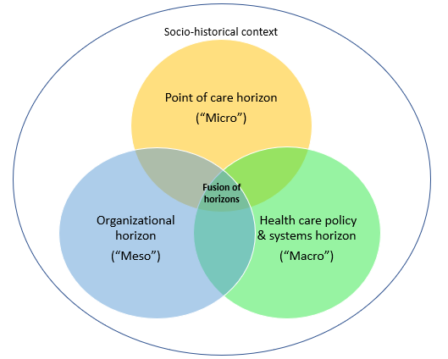
1. Use of PROMs involves interpretation of contextual elements
Micro-level: Patients and clinicians may use PROMs to inform individualized care.
Meso-level: Clinicians and administrators may use PROMs to compare the quality of the care provided.
Macro-level: Administrators and policy-makers may use them to assess the effectiveness of treatment protocols and health care policy.
By recognizing contextual elements, we may be able to better attend to the tensions embedded within healthcare system levels
Notes:
Fusion of horizons.
Understanding use of PROMs from these different perspectives within the broader socio-historical context enables us to uncover intentions and values that may be hidden from multiple overlapping and at time competing priorities in the health care system.
In the UK in 2010, National Health Services changed their policy for pts needing hernia repair to watchful waiting.
There was a lot of controversies in how they made their decisions- from just economic reasons to how they misinterpreted PROMs data to make their decision.
1) criticism of using a measure that was not sensitive post hernia repair 2) political decision because NHS consulted with McKinsey and Co., which is a consulting company to make their decision, rather than consulting with a wider group of clinicians or patients.
Research showed that watchful waiting policy led to more emergency hernia repair and complications.
Good framework to show how we can better attend to the tensions and show whose perspectives may have been ignored.

Slide 8
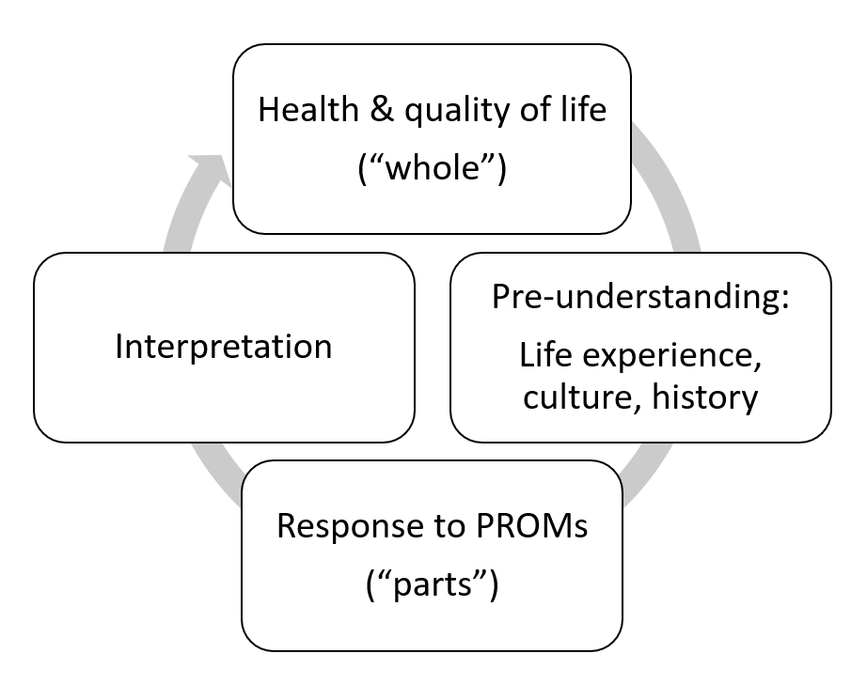
2. Interpretation of PROMs is an ongoing dialectical interaction
Our understanding of the “whole” is based on understanding its various components (e.g., Responses to PROMs are based on patients’ pre-understanding, which may then need to be interpreted to indicate patients’ health & quality of life).
By recognizing this dialectical interaction, we can provide more transparency to our interpretation of PROMs
Notes:
Hermeneutic Circle
If we are looking at responses to patients’ PROMs scores or parts, these responses are based on patients’ on life experience so for example, SF-36, generic PROMs measure, has one item that asks about their physical activity which includes playing golf. If someone has never played golf, they might answer this question differently from someone who has played golf. And from these responses, we would need to interpret patients’ health & QoL. Different measures have different domains (e.g., spiritual domain) included in the assessment of health and QoL. Patients may change the domains that are important over time (response shift) and those who are interpreting the “parts” for example clinicians may have their own idea of patients’ health and QoL, which can all influence our understanding of the “whole”.
For example, our clinical understanding of good health and QOL may be effective seizure management for pts who have epilepsy, but pts may be more worried about treatment affecting their social function more than having no seizure.
This is really about recognizing how these various components interact, and to identify our assumptions, to better understand and obtain a more accurate picture when we are interpreting patients’ health and quality of life.

Slide 9
3. Use of PROMs involves openness and reflexivity
“What is the extent to which it is possible to communicate the full meaning of health and quality of life through the use of a standardized questionnaire?”
PROMs are classified into two categories:
Generic PROMs (e.g., SF-12)
Condition-specific PROMs (e.g., FACT-C colorectal cancer-specific)
Being open and reflexive can help to improve the validity of interpretation based on PROMs scores
Notes:
What is possible and where is the limitation?
PROMs scores should not be taken at face value but rather be viewed as a way to open a dialogue about the measure.
Depending on the measure, different domains make up overall concept of health and Qol.

Slide 10
Considerations
Tenets | 1. The use of PROMs involves the interpretation of contextual elements | 2. Interpretation of PROMs is an ongoing dialectical interaction | 3. The use of PROMs involves openness and reflexivity
Practical implications | Develop standards regarding implementation, interpretation, and reporting on PROMs for different micro-,meso-, and macro-levels | Articulate any views that may influence interpretation of PROMs data and decisions made on the basis of it | Promote openness and reflexivity in understanding the meaning underlying PROMs
Key guiding questions | What is the purpose of using PROMs in this context? Whose perspectives are served and/or possibly ignored? | How are my assumptions, beliefs and theories informing the interpretation and use of PROMs? | Does this PROM seem to adequately capture the implied construct for this population?
Consequences of asking these questions | Helps to seek a balanced appreciation for the different purposes of PROMs use. | Provides more transparency to the interpretation and use of PROMs | Improves the validity of interpretations based on PROMs scores.

Slide 11
Thank You !
Questions?
Jae Yung Kwon, RN, PhD (c)
Registered Nurse & PhD Candidate, School of Nursing, UBC (sub-specialization in Measurement, Evaluation and Research Methodology, Faculty of Education, UBC)

